Slide 1



LIBRARY HUB
YOUR INSTANT ANSWER TO "CAN YOU PLEASE SEND ME THE NOTES?”
PRESENTED BY : MAYUR RASTOGI
LUCKY TOMAR
YASH RASTOGI
This Photo by Unknown Author is licensed under CC BY

Slide 2

GROUP OF INSTITUTIONS
CSWD MIET
TABLES OF CONTENTS :
INTRODUCTION
PROBLEM STATEMENT
SOLUTION
HARDWARE AND SOFTWARE USED
REFERENCE

Slide 3

GROUP OF INSTITUTIONS
INTRODUCTION
CSWD MIET
“ LIBRARY HUB “ is a platform where you are able to get notes in a single click . In short, it is your friend that is never busy to help you with notes that too for absolutely free.

Slide 4

GROUP OF INSTITUTIONS
CSWD MIET
PROBLEM STATEMENT
There are a lot of people who does not able to get notes easily due to financial conditions or lack of notes availability . Therefore , most of students are always depends on there friend to send them pdf of notes of particular subject.

Slide 5

GROUP OF INSTITUTIONS
CSWD MIET
solution
Our moto is to develop a website that provides all the notes in a single click , so now student’s don’t have to worry and waste there time in clicking and making pdf’s of more than 100 pages . Plus now you don’t have to wait for your friend to send notes.

Slide 6



GROUP OF INSTITUTIONS
CSWD MIET
Library hub
Handwritten notes
Previous year question paper
Compact notes
This Photo by Unknown Author is licensed under CC BY-NC-ND

Slide 7

GROUP OF INSTITUTIONS
CSWD MIET
Hardware used:
PROCESSOR - AMD Ryzen 7 5800H
MAIN MEMORY - 512 SSD
RAM - 8 GB
GRAPHIC CARD - 4GB
SYSTEM TYPE - 64-bit operating System, x64-based processor

Slide 8

GROUP OF INSTITUTIONS
CSWD MIET
SOFTWARE used:
PROGRAMMING LANGUAGE - HTML,CSS
SOFTWARE USED – VS CODE
OPERATING SYSTEM – WINDOWS 11
This Photo by Unknown Author is licensed under CC BY

Slide 9
GROUP OF INSTITUTIONS
REFRENCE:-
CSWD MIET
HTML , CSS BY – YOUTUBE
SEARCH ENGINE – GOOGLE

Slide 10
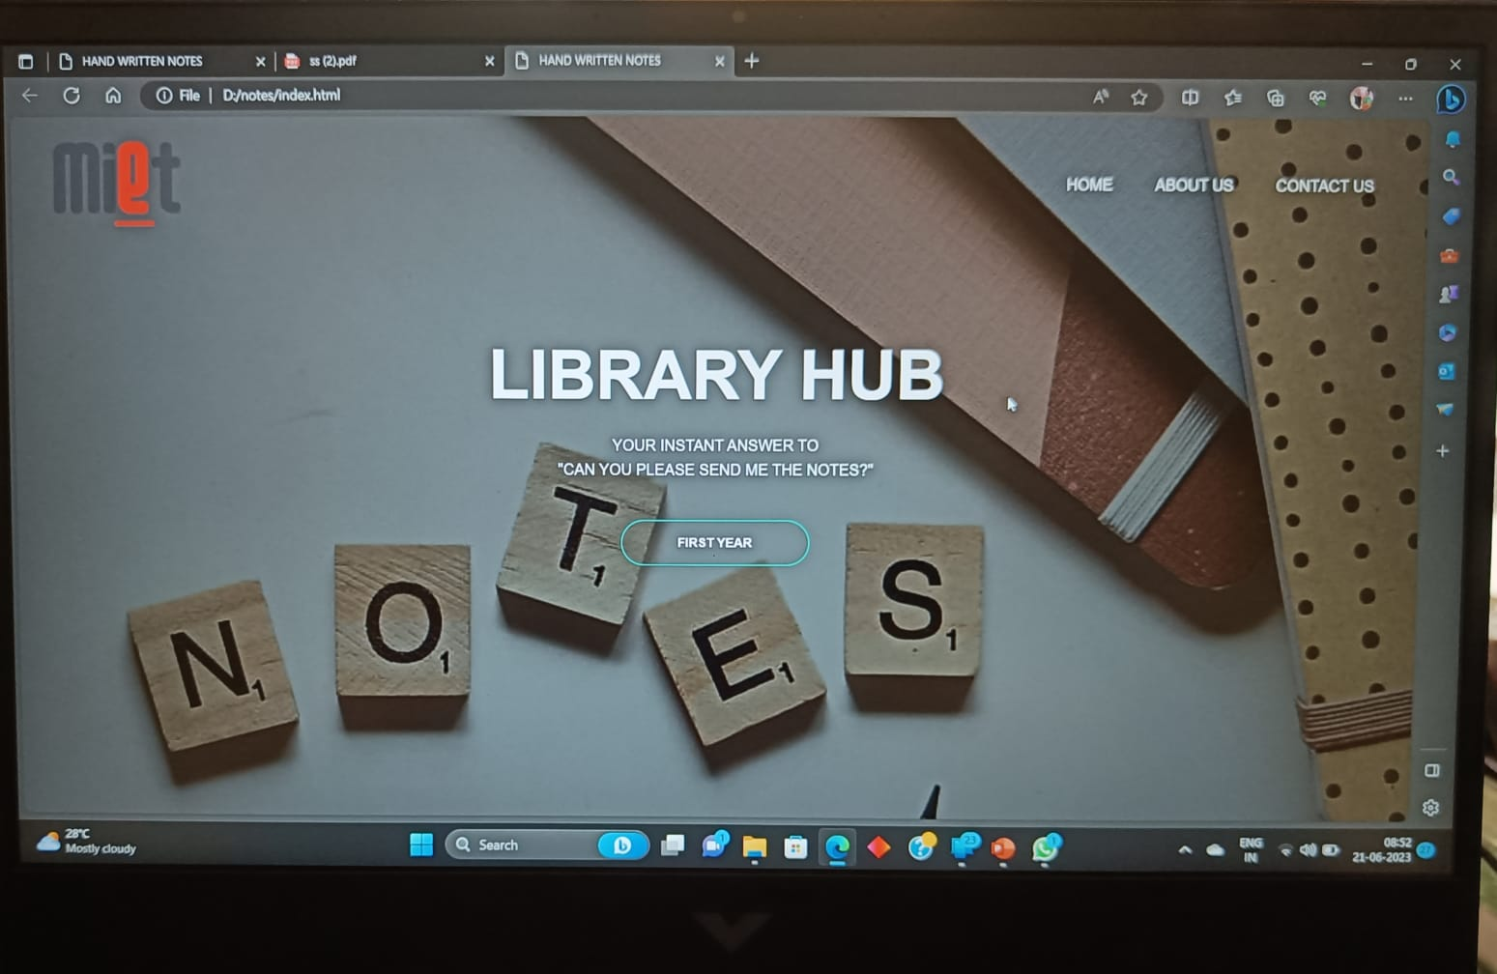

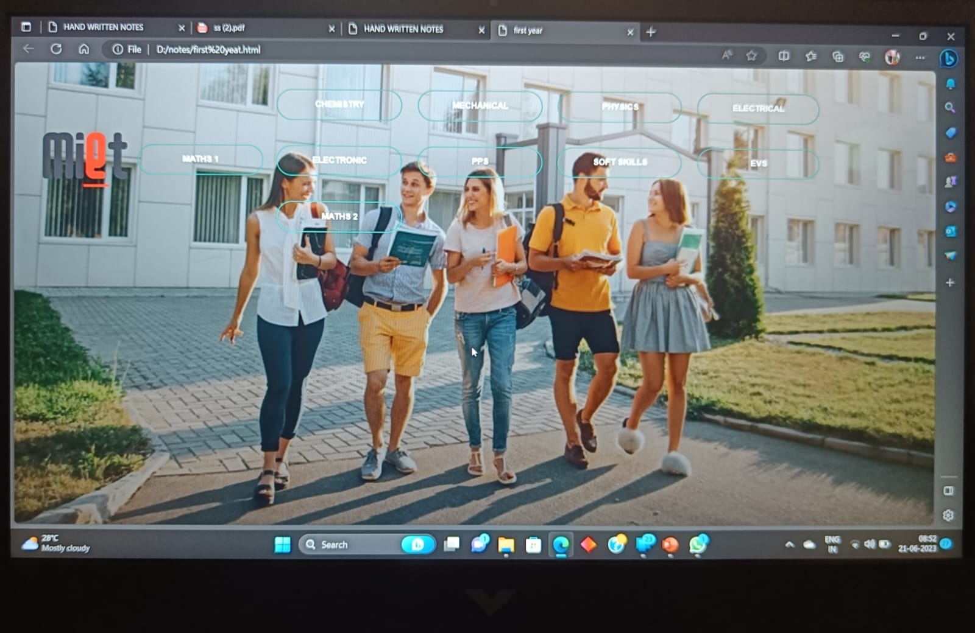
GROUP OF INSTITUTIONS
Content :-
CSWD MIET
Preview 1
Preview 3
Preview 2

Slide 11

Thank you

